Slide 1
Biotechnology and Bacterial Transformation
ABE Lab sequence

Slide 2
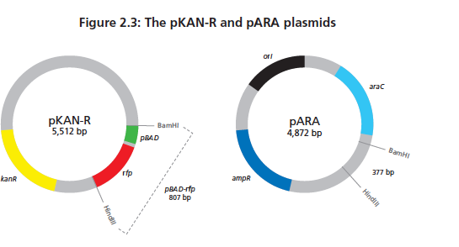
Creating a Recombinant Plasmid

Slide 3
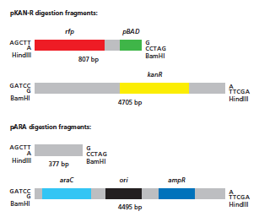

Slide 4
Restriction and Ligation
We used restriction enzymes to cut the two plasmids at the certain points
The LIG tube contained ligase and ligation buffer. The buffer also had the ATP necessary to help create the bonds
How do we confirm that we got ligation of the plasmid?
What traits do we want in the new plasmid?

Slide 5
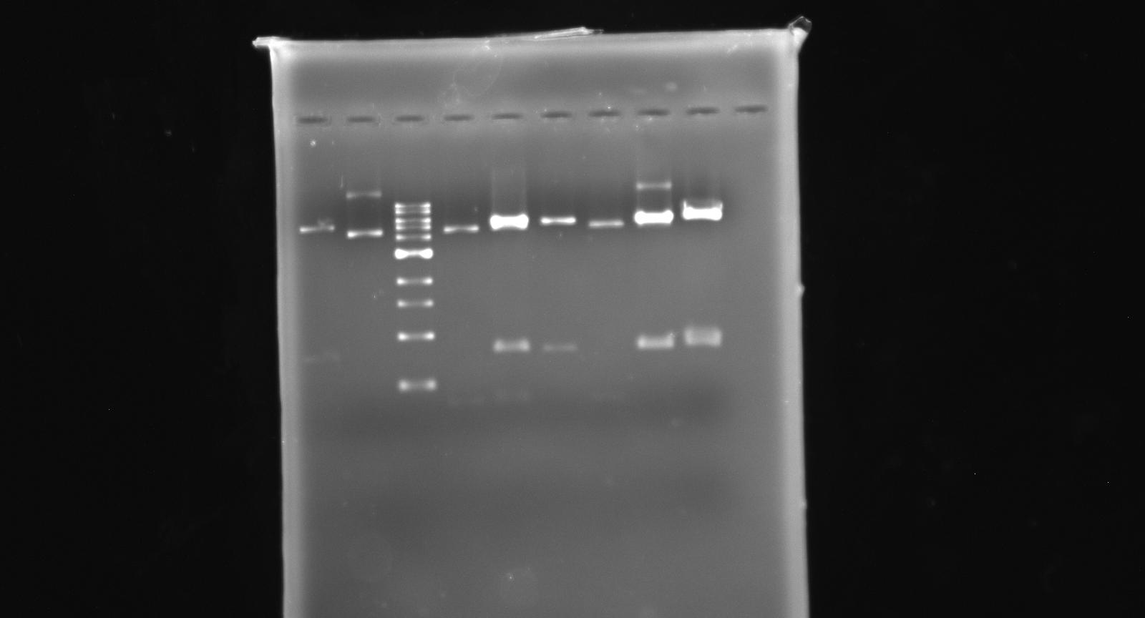
Reading Your Gel

Slide 6
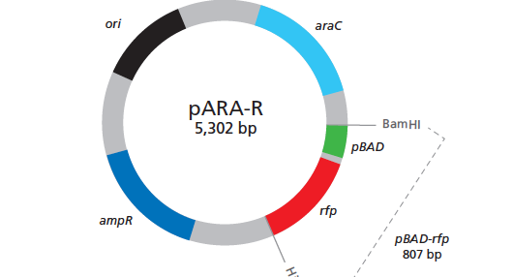
The p-ARA-R plasmid

Slide 7
Steps of Bacterial Transformation
1. Competency: Preparing the bacterial cells to receive DNA.
Place bacteria into CaCl₂ = CaCl₂ weakens pores in cell wall.
Rack = breaks up clumps
Cold = prepares Bacteria for next step, concerning opening and closing the membrane.

Slide 8
2. Transformation: Insert the new plasmid DNA via the pores.
Finger flick = makes DNA touch ALL bacterial cells
Heat Shock = opens pores in the membrane suddenly and pulls in DNA.
Exactly 45 secs. is needed to get DNA deep in Bacteria
Cold = closes pores. Keeps some new DNA in bacteria.

Slide 9
3. Growth: Resting and feeding stage.
LB Broth (750μL = just enough food for overnight, if you have too little food, bacteria would not be able to grow and reproduce.)
37ºC (Body Temp.) is the perfect temp for bacteria to grow and reproduce

Slide 10
4. Isolation: Separate the few transformed cells from the entire population.
Ampicillin inhibits growth of bacteria (does not kill) by breaking down cell walls and not allowing bacteria to reproduce.
Only amp resistant bacteria will be able to reproduce.
Satellite colonies form when a bacterium degrades the amp around the cell, enabling other bacteria to reproduce.

Slide 11
5. Expression: Phenotypic expression.
Arabinose is needed to turn on the rfp gene.
Think about what you know, what type of operon is this?
Expect that all the E.coli that can grow in the presence of ampicillin has been transformed. How do we check to make sure?

Slide 12
Expected results
LB agar plate
LB/ Ampicillin
LB/ AMP/ARA
- You need to record number of colonies and color for both +DNA and -DNA plates

